Slide 1
LGBTQI (PLUS) and HIV RELATED ASYLUM CLAIMS
Jose Marin Law
An Immigration Law Firm
1630 Taraval Street, Suite #B
San Francisco, CA 94116
Phone: 415-753-3539
Presenters: Jose Z. Marin Esq. and Melanie A. Kehr Esq.

Slide 2
Disclaimer
Please note that this presentation is provided for general informational purposes only. Information presented does not constitute legal advice. Although we strive to keep our information current, it may not be up-to-date and is subject to change without notice. Attorneys should conduct their own independent research and analyses to ensure current and situation-specific legal assessments; individuals without an attorney should consult with one.

Slide 3
BASIC CONCEPTS AND DEFINITIONS RELATED TO LGBTQI (PLUS) ASYLUM CLAIMS
Sexual Orientation | An emotional, romantic, or sexual attraction to or desire for others.
Gender Identity | A self-concept as being female, male, both, neither or other gender identity.
Gender Expression | One’s external appearance of one’s gender identity perceived as masculine or feminine.
Transgender | Gender identity, assigned at birth, does not conform to self-assigned gender identity.
Gender Transition | Alignment of gender identity with outward appearance and behavior of specific gender.
Gay | (Homosexual) Men who are attracted to men.
Lesbian | (Homosexual) Women who are attracted to women.
Bisexual | Emotionally, romantically or sexually attracted to more than one sex, gender or gender identity though not necessarily simultaneously, in the same way or to the same degree.
Heterosexual or Straight | People who are attracted to another sex.
Intersex | People whose genitalia is atypical in physical appearance (independent of Gender Identity)
For more information see Human Rights Campaign Glossary at: http://www.hrc.org/resources/glossary-of-terms
Notes:
Discuss polyamory

Slide 4
IMPORTANT FORMS AND REQUESTS
G-639 FOIA REQUEST
G-28 AND/OR EOIR-28
I-589 APPLICATION FOR ASYLUM AND WITTHOLDING OF REMOVAL
Copy of principal for each derivative applicant
I-765 APPLICATION FOR EMPLOYMENT AUTHORIZATION
ASYLUM CLOCK: Eligible, if applicant has not caused any delays, only 180 days after application has been pending, BUT can file after 150 days because USCIS takes 30 days to process
BIOMETRICS
DHS serves notice, but can file with USCIS, for those 14 and older
Can send by email: USCIS.FOIA@uscis.dhs.gov and ask for expedited Track 3 if pending hearing in EOIR
Entry Of Attorney Appearance

Slide 5
common sources of asylum law
International Law (UN Conventions, Treaties; Convention Against Torture important)
Immigration and Nationality Act (“INA”) §208 or US Code (8 U.S.C. §1158)
Refugee Act of 1980
Illegal Immigration Reform and Immigrant Responsibility Act
U.S.A. Patriot Act
The REAL ID Act
The Trafficking Victims Protection Reauthorization Act of 2008
Code of Federal Regulations
Board of Immigration Appeals Decisions
Federal Court Case Law
Attorney General Opinions
Policies, Manuals, by Federal Administrative Agencies, etc.
Foreign Law
Notes:
UN passed the Resolution on Human Rights, Sexual Orientation and Gender Identity in 2011

Slide 6
general asylum ELIGIBILITY: the starting point
The applicant must be present in the U.S. (( Section 208(a)(1) of the Immigration and Nationality Act (“INA” or “the Act”)))
There is no third country to which the alien can be safely removed (Section 208(a)(2)(A)).
The applicant must have applied for asylum within one year of arrival to the U.S. (Section 208(a)(2)(B) unless inapplicable under §§208(a)(2)(D) or (E)).
The applicant’s asylum claim has not been previously denied (Section 208(a)(2)(C)) unless inapplicable under §§208(a)(2)(D) or (E)).
The applicant credibly proves that he or she is a refugee (Section 208(b), refugee defined under §101(a)(42) of the Act).
The applicant is not or has been 1) a persecutor, 2) convicted of a particularly serious crime, 3) an aggravated felon, 4) a terrorist, or 5) an applicant who resettled in another country prior to coming to the U.S. (See §208(b)(2)(A) of the Act).

Slide 7
Derivatives
Status at the time of filing the application or prior to final decision
Spouses, unmarried children under 21 years old born or conceived prior to decision, step-children if relationship existed prior to age 18
Proof of relationship: birth certificate, marriage license, divorce decrees, adoption papers
Now that DOMA has been repealed, same-sex spouses qualify

Slide 8
Affirmative vs. defensive ASYLUM
Affirmative is with the asylum office, USCIS
Unaccompanied Alien Children (UAC)
Has valid immigration status (visitor visa, TPS) or status has elapsed
Entered without inspection and not in removal proceedings
Defensive is with EOIR, when client is in removal proceedings
Served with NTA and case filed, after either:
Referred to IJ if found ineligible for affirmative asylum, or
Caught at port of entry or within U.S. without proper documents, or
CBP caught you trying to enter without documents, given credible fear interview (must show “significant possibility” you can establish eligibility with IJ)

Slide 9
ONE YEAR BAR
Must apply for asylum within one year of most recent entry into the U.S. (day zero)
Lodge, file at window EOIR, or mail to USCIS prior to one year deadline (“clear and convincing evidence”)
Exceptions
For Exceptions, must demonstrate “to the satisfaction of the AG”, low standard
Gather evidence, ask DHS if this is at issue or stipulation
Must file within “reasonable period”
Considering education, socioeconomic status, age, mental health, etc.
Unaccompanied Alien Children
Changed Circumstances materially affects eligibility
Delay not caused by applicant Matter of Y-C-, 23 I&N Dec. 286 (BIA 2002)
Extraordinary Circumstances directly related to delay
Notes:
Must apply for asylum within one year of most recent entry into the U.S. (day zero)
Lodging used to be method to preserve one year bar when not ready to file or MCH was not scheduled in time
Now you can file at the window, but can still lodge
Exceptions:
Unaccompanied Alien Children (child with no lawful status under age 18, no parent or legal guardian in U.S.)
Changed Circumstances materially affects eligibility (ex. govt or person in home country is a threat now)
INA §208(a)(2)(D), 8 CFR §§208.4(a), 1208.4(a) (2014).
Extraordinary Circumstances directly related to delay not caused by applicant (ex. death in family, illness, ineffective assistance of counsel, minor applicant)
8 CFR §§208.4(a)(5), 1208.4(a)(5) (2014); Matter of Y-C-, 23 I&N Dec. 286 (BIA 2002)
Must demonstrate “to the satisfaction of the AG”, low standard;
gather evidence:
Medical records, country conditions, psych eval
Ask DHS if this is at issue
Can discuss with sf duty attorney, can email them or call, or at the master hearing if one year bar is at issue;
still it is the judge’s determination
Must file within “reasonable period”: considering education, socioeconomic status, age, mental health, etc.
8 CFR §§208.4(a)(4)(ii), 1208.4(a)(4)(ii) (2014).
There is caselaw on this, specific to each circuit

Slide 10
One year bar for lgbtqi
Unaware that sexual orientation/gender identity is ground for asylum
PTSD
Family or community isolation
“Sur Place”: new events give rise to claim…
Takes time to accept identity
HIV/AIDS new diagnosis or medical complications
Gender transitioning/can’t “pass”
Marriage to same-sex partner
Country recent crackdown on LGBT rights
Notes:
Unaware:
Common that people understand political asylum but not sexual orientation etc.
Family isolation
Many LGBTI stay with family members or community from home country, fear of being found out and disgraced
New claims
Many countries do not have confidentiality laws protecting HIV status, so some LGBT people fear that their HIV status could become widely known. In many countries, being HIV-positive is equated with being LGBT, and so their LGBT identity would become known.

Slide 11
Refugee
“Any person …who is unable or unwilling to return to, and is unable or unwilling to avail himself or herself of the protection of, that country because of persecution or a well-founded fear of persecution on account of race, religion, nationality, membership in a particular social group, or political opinion….
Difference between refugee and asylee:
Refugee | Outside U.S. territory, falls under INA § 207
Asylee | Already physically present in the U.S., need protection and seek admission
Notes:
We don’t practice refugee law outside country, but applicants go through programs available in other countries

Slide 12
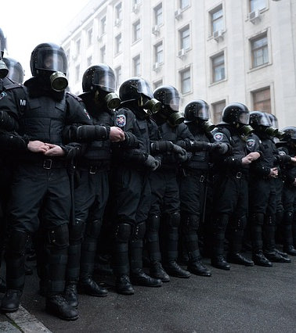
Unable/unwilling to return, and Unable/UNWILLING TO AVAIL SELF OF GOVERNMENT PROTECTION
If persecutor non-government, must show government unable/unwilling to control/protect from persecution
If persecutor government – no need to demonstrate that client sought their protection. Baballah v. Ashcroft, 367 F.3d 1067, 1078 (9th Cir. 2004).
Can show through Country Conditions, Direct Statements from Persecutor…
Exs: War, ethnic cleansing, law enforcement and judiciary corruption, failure to enforce laws, inability to express beliefs safely, etc.
Notes:
Non government actors:
That the government was asked to intervene and did not, or condoned the behavior through cultural biases
Not reasonable for applicant to seek protection because it would be futile, can give explanation about how this happened to others or that it’s common knowledge they don’t help
Government actors:
Police, military, politicians;
If govt actor is persecutor, burden shifts to DHS to prove internal relocation would avoid future persecution

Slide 13
Persecution defined
“A threat to the life or freedom, or the infliction of suffering or harm upon, those who differ in a way regarded as offensive” Matter of Acosta, 19 I&N Dec. 211, 222 (BIA 1985), Matter of Kasinga, 21 I&N Dec. 357, 365 (BIA 1996).
Clear Examples: | Other serious harm that may rise to the level of persecution:
Genocide, Slavery, Torture, Inhuman/Cruel/Degrading Treatment, Rape, Sodomy, Other Sexual Violence, Violation to be recognized as a person in the law, Violation of right to freedom of thought, conscience, religion or belief. | Threats to life, Sexual assault, Sexual abuse, Female genital mutilation, Coercive population control, Beatings, Threats or Physical attacks, Arrests, Forced labor, Forced “treatments,” Denaturalization, Deportation, Kidnappings coupled with threats or beatings, Inability to earn a livelihood, Deprivation of education, Confiscation/deprivation of property, Compulsion to engage in acts against deepest beliefs, etc.
Notes:
Why make distinction here?

Slide 14
Past persecution
Creates rebuttable presumption that applicant has well-founded fear of future persecution
DHS will argue change of circumstances/country conditions or internal relocation
May be more difficult to establish for LGBTI who kept lives secret
Well founded fear
“Reasonable possibility” of persecution if return: less than a 10% chance sufficient. See Matter of Mogharrabi, 19 I&N Dec. 439, 445 (BIA 1987); Matter of S-S-, 21 I&N Dec. 121, 122 (BIA 1995); INS v. Cardoza-Fonseca, 480 U.S. 421, 431, 440 (1987)
Can argue well founded fear even if applicant never experienced past persecution
Ex. Someone who came out recently after living in the U.S. or contracted HIV here
If past persecution, but no well founded fear, argue Humanitarian Asylum:
Compelling reasons, severity of past persecution, reasonable possibility other serious harm. See Matter of Chen, 20 I&N Dec. 16 (BIA 1989); See Matter of L-S-, 25 I&N Dec. 705 (BIA 2012)
No nexus required for other serious harm; forward-looking
Notes:
Country conditions:
even if lgbti organizations exist or pride parades, or laws on books, still may be violence
Internal relocation:
Must be able to access rights, not be forced to “hide” identity to avoid harm
Huumanitrian:
Severity:
(1) duration of persecution;
(2) intensity of persecution;
(3) age at the time of persecution;
(4) persecution of family members;
(5) conditions under which the persecution was inflicted;
(6) whether it would be unduly frightening or painful for the applicant to return to the country of persecution; and
(7) whether there are continuing health or psychological problems or other negative repercussions stemming from the harm inflicted. Although the severity of past harm can yield a grant of asylum even if there is no well-founded fear of future persecution, the applicant still must demonstrate that the severe harm was suffered on account of a protected characteristic.

Slide 15
Persecution CASE LAW
Physical Harm | See INS v. Stevic, 467 U.S. 407 (1984)
Threats | See Salazar-Paucar v. INS, 281 F.3d 1069, 1074 (9th Cir. 2002), amended by 290 F.3d (9th Cir. 2002).
Psychological Harm | See Mashiri v. Ashcroft, 383 F.3d 1112 (9th Cir. 2004), Khup v. Ashcroft, 376 F.3d 898, 904 (9th Cir. 2004)
Harm to Family Members or Third Parties | See Matter of A-K-, 24 I&N Dec. 275, 278 (BIA 2007)
Severe Economic Disadvantage or Deprivation of Essentials of Life | See Matter of Laipenieks, 18 I&N Dec. 433, 456-57 (BIA 1983), Matter of T-Z-, 24 I&N Dec. 163 (BIA 2007), Baballah v. Ashcroft, 367 F.3d 1067, 1075 (9th Cir. 2004), and others.
Arrests and Detention | See Mihalev v. Ashcroft, 388 F.3d 722 (9th Cir. 2004)
Harassment and Discrimination | Generally not enough alone. However, harm must be considered in the aggregate. See Matter of O-Z- & I-Z-, 22 I&N Dec. 23, 26 (BIA 1998)
One Incident can be enough | See Mihalev v. Ashcroft, 388 F.3d 722 (9th Cir. 2004)
Notes:
Psychological Harm does not have to be with the intent to harm the survivor.

Slide 16
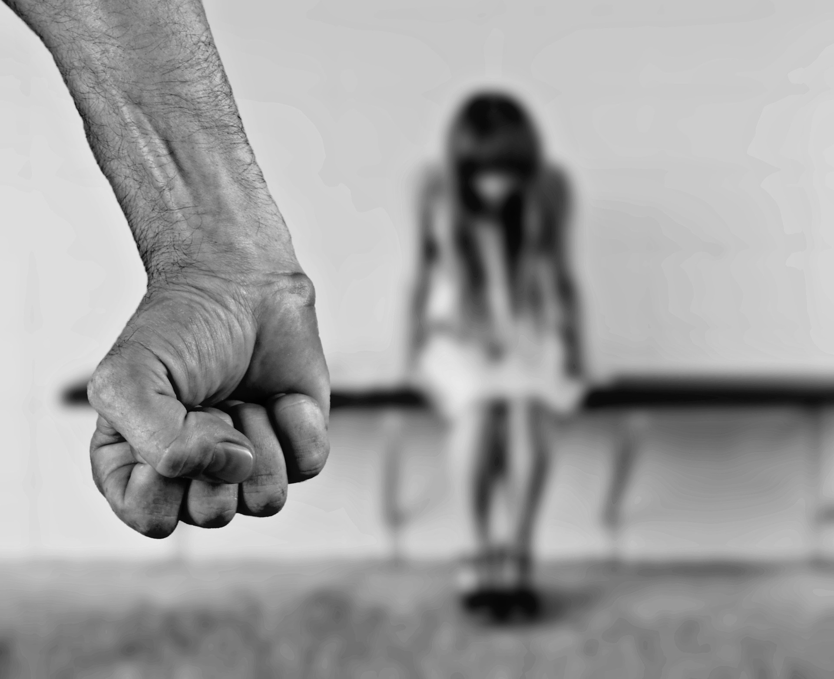
Persecution OF LGBTQI and hiv
Rape, or threats like “ill teach you how to be a real woman”
Discrimination in work place, economic deprivation, or with the courts
Cumulative harrassment
Beatings
Torture
Medical experiments
Therapy or programs meant to “cure” people of their gender identity or sexual orientation
Arrests, Prosecution or Imprisonment for being gay (or for “immoral acts” or other crimes like rape)
Being forced to “out” friends to police
Forced marriage (lesbians at higher risk, often less powerful than men and defined by role as “wife”)
Pressure to stay closeted or identify as particular gender (Intent to harm is not always required)
Denial of access to HIV medication or transition hormones/surgery

Slide 17
PARTICULAR SOCIAL GROUP (PSG) and NEXUs
“persecution…on account of… membership in a particular social group….” (§101(a)(42) of the ACT).
Nexus: “on account of” = one central reason for persecution

Slide 18
Membership in a PSG
Step One: Articulate a Cognizable Group. In order to have a cognizable group the group must:
Composed of members who share common, innate characteristic, immutable or fundamental to their identity (Matter of Acosta)
For LGBTQI: Start with Sexual Orientation (makes the group much stronger):
For example, HOMOSEXUAL (Immutable and Fundamental)
Follow with visible characteristic (ocular not required, Matter of M-E-V-G-) such as Gender Expression or Gender Transition:
Defined with particularity and social visibility (Matter of S-E-G-, 24 I&N Dec. 579, 584-88 (BIA 2008); Matter of M-E-V-G-, 26 I&N Dec. 227, 239 (BIA 2014)
For example, EFFEMINATE (Fundamental)
Refine with a Fundamental or Immutable Characteristic:
For example, RUSSIAN (Fundamental)
Narrow down with Gender Identity:
For example, MALES (Fundamental)
Close with a final immutable or fundamental characteristic:
For example, LIVING WITH HIV
Can’t be circular/defined by the harm: “Men raped for being gay”
“Homosexual Effeminate Russian Males living with HIV”
Notes:
Can be imputed to the applicant
So even if not lgbt, if the persecutors perceived them to be part of that group
For HIV, even if it was through blood transfusion, needles or pregnancy, people in home country may assume from sexual activity
Does applicant know of others persecuted for same experience? How?
Bisexual: even if in heterosexual relationship, may be perceived as gay
Nexus:
What did persecutor say during the harm?
Where did harm occur? In a gay bar or when holding hands with same-sex partner?
Are there laws on the books either protecting or harming group?
Did persecutor harm others in the group?
Not all members of the group must be at risk of persecution
They don’t have to exhibit “flamboyant” or stereotypical characteristics
Can also tie it to other group, like family/kinship ties if a family member was the persecutor, or domestic violence if partner abuse

Slide 19
LGBTQI AS (IMPUTED) POLITICAL OPINION
Must provide some evidence,” “direct or circumstantial,” that the persecutor was motivated by a belief that the applicant held the political opinion. See Khudaverdyan v. Holder, 778 F.3d. 1101, 1111 (9th Cir. 2015)
Testimony regarding a persecutor’s statements about motive is direct evidence that the applicant’s political opinion motivated the persecution. Singh v. Holder, 764 F.3d 1153, 1159 (9th Cir. 2014).
Imputed: A petitioner’s “association with, or relationship to, people who are known to hold a particular political opinion” may serve as indirect evidence of imputed political opinion.
Political protesting
Flying flag
Telling persecutor that you have rights
Exposing human rights abuses
Reporting crime to police or testifying as witness
Voting for party that supports rights or membership in activist group
Appearance that you are in any of these groups, supporting family or friends
Persecutor has made statements about your “beliefs” as a reason for the harm
Notes:
Can have “mixed motives” for persecution, like political opinion or religion

Slide 20
Precedent and resources FOR LGBTQI/HIV PSG
Castro – Martinez v. Holder, 641 F.3d 1103 (9th Cir. 2011) (amended by Castro – Martinez v. Holder, WL 6016162, Dec. 5, 2011 (9th Cir. 2011) - gay man from Mexico
Boer-Sedano v. Gonzales, 418 F.3d 1082, 1091 (9th Cir. 2005) - internal relocation unreasonable: cumulative evidence of serious harm to gay man in Mexico because unable to obtain required medication
Pangilinan v. Holder, 568 F.3d 708 (9th Cir. 2009) - transsexual woman from the Philippines
Eneh v. Holder, 601 F.3d 943 (9th Cir. 2010) - man living with AIDS from Nigeria
SEMINAL CASE: Matter of Toboso-Alfonso, 20 I&N Dec. 819 (BIA 1990) - recognizing homosexuality as an immutable characteristic
Karouni v. Gonzales, 399 F.3d 1163 (9th Cir. 2005) - all alien homosexuals are member of PSG
Morales v. Gonzales, 472 F.3d 689 (9th Cir. 2007) - transgender identity
Avendano-Hernandez v. Lynch, 800 F.3d 1072 (9th Cir. 2015) - transgender women distinct from gay men
Hernandez-Montiel v. INS, 225 F.3d 1084 (9th Cir. 2000).
Legacy INS memo - HIV is PSG - http://www.immigrationequality.org/wpcontent/uploads/2011/07/HIV-asylum-memo.pdf
United Nations High Commissioner for Refugees (UNHCR), Protection, Policy, and Legal Advice Section. http://www.unhcr.org/refworld/docid/48abd5660.html
Memorandum USCIS, Adjudication of Petitions and Applications Filed by or on Behalf of Transsexual Individuals (January 14, 2009).
Memorandum USCIS, Adjudication of Petitions and Applications Filed by or On Behalf Of, or Document Requests by, Transsexual Individuals (April 16, 2004).
Notes:
Can have “mixed motives” for persecution, like political opinion or religion

Slide 21
WHAT TO FILE
Client Declaration
Important to request FOIA and review statements made to ICE, CBP, Asylum Officer during credible fear interview (if there is one)
Country Conditions
Legal Brief
If affirmative filing with USCIS, can be cover letter
If EOIR, make sure to follow judge order
ID Documents and Corroborating Evidence
Birth certificate and other ID documents (certified translation into English)
Other Evidence from client
EOIR Virtual Law Library good starting point: https://www.justice.gov/eoir/virtual-law-library
CGRS
Human Rights Watch LGBT division, Amnesty International, International Gay and Lesbian Human Rights Commission
Notes:
Declaration:
Should be detailed enough that client can describe coming out story if that exists, first started to realize sexual orientation, and how they felt
Explain incidents of violence; be careful if memory issues to be too specific about dates/times
Country conditions:
Even if laws on gay rights, may not be in practice
May not be a lot of reporting on gay rights or violence in countries with most restrictive culture

Slide 22
EVIDENCE TO GATHER FROM CLIENT
Evidence corroborating harm and PSG (*If possible! Often unable to get evidence; credible testimony alone sufficient)
Granting asylum as matter of discretion
Medical records of injuries, or related to PSG such as transition procedures, hormones, etc.
Photos of injuries
Text messages, emails, etc. from persecutor
Police reports
Expert and Lay Witness affidavits
Psych. Eval. (therapist must be willing to testify)
News articles specific to client
Membership in LGBTI groups
Letters of Support from schools, religious organizations, family, friends, employer
(working without EAD is not a bar to asylum, but may need to waive at AOS level for unlawful presence)
Tax returns
Any charitable work
Education, learning English
Discuss life here, hopes for future

Slide 23
THANK YOU for HELPING THE LGBTQI (PLUS) AND HIV COMMUNITY!

